Slide 1
Final Voyage of the SSV Dionysus
By Pleiades Project
Anusha Rao - Art Concepts
Logan Smith - Programming
Deandra Brown - Art Assets
Ayselah Smith - Art Assets
Joey Tse - Programming/Level Design

Slide 2
Game Overview
Story:
The main Player is an astronaut whose crew has gotten shipwrecked while on a space mission.
The player is lost in a dimension far away
Main Objective:
As a player, you need to move through 5 dimensions in order to get back to your dimension and return home with your crew.
POV:
Behind the ship to allow you much more control over dodging

Slide 3
Gameplay
Progression:
After defeating waves of enemies and dodging obstacles, there will be a final “guard” blocking the player from progressing
This final guard may be the same as from previous levels, but with new attacks and features added
Rewards/Loot:
At the end of each level, the player is presented with a random ship feature that changes how they play
Player can reject the new item if they like their current build

Slide 4


Potential Platforms

Slide 5
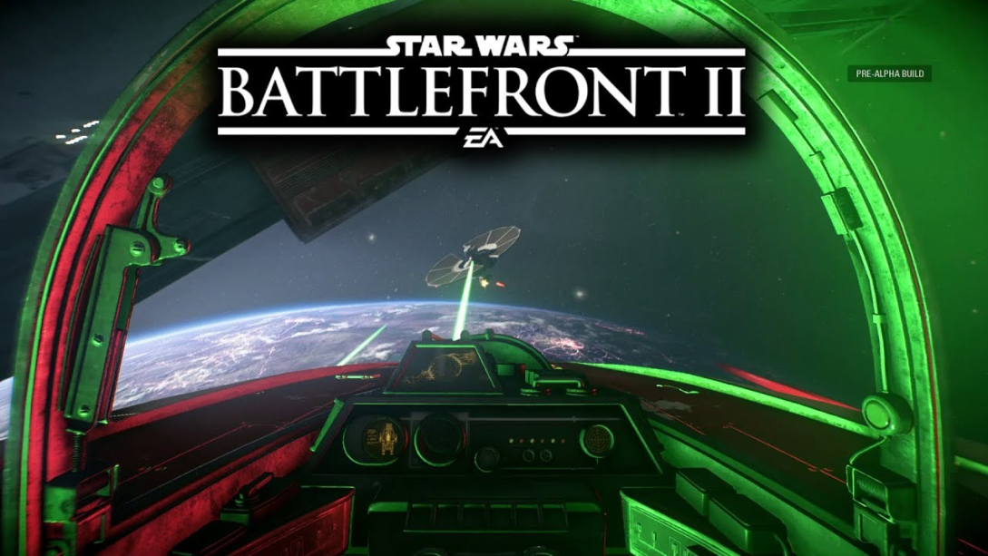
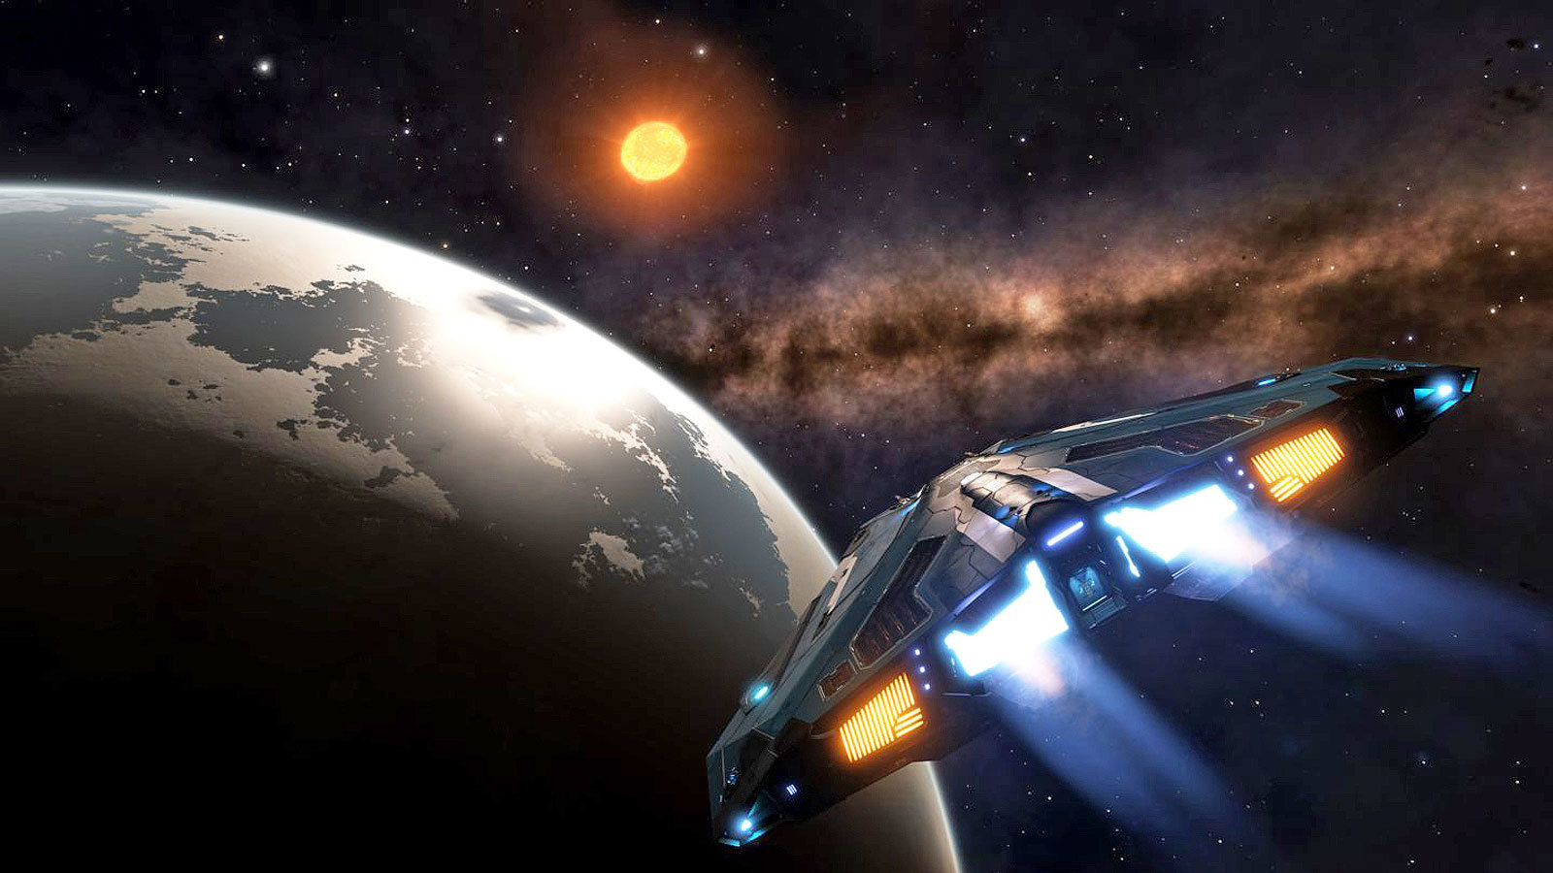
References/ Inspiration

Slide 6
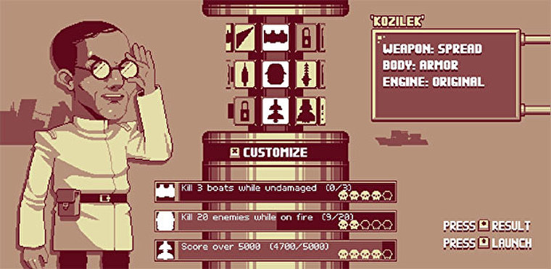
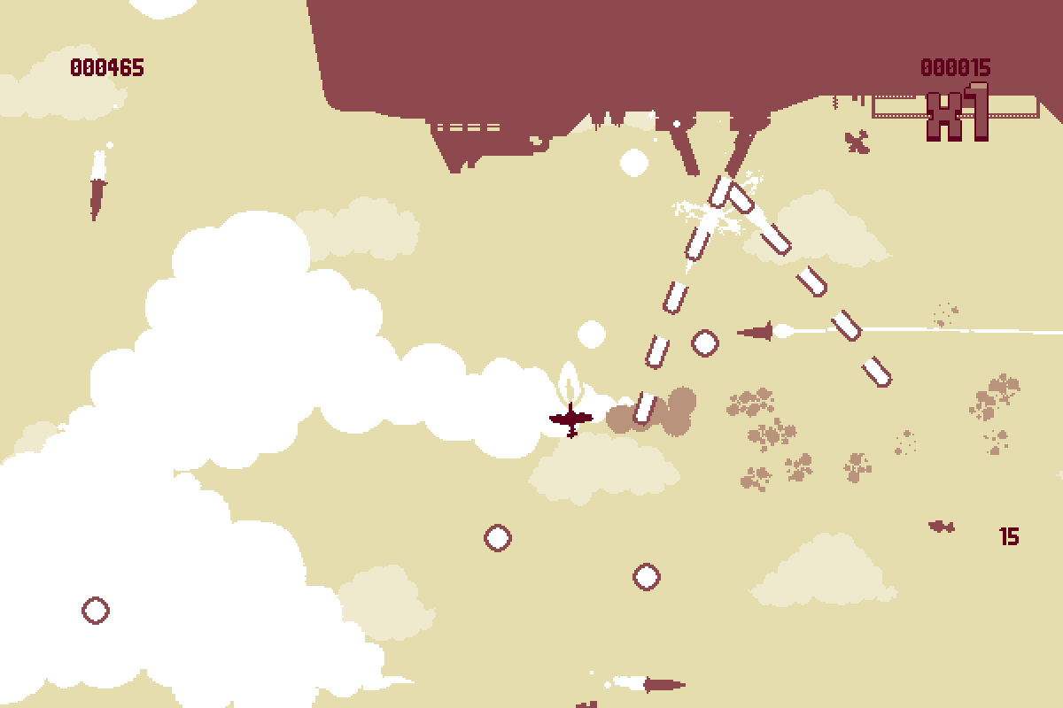
References/ Inspiration

